Slide 1
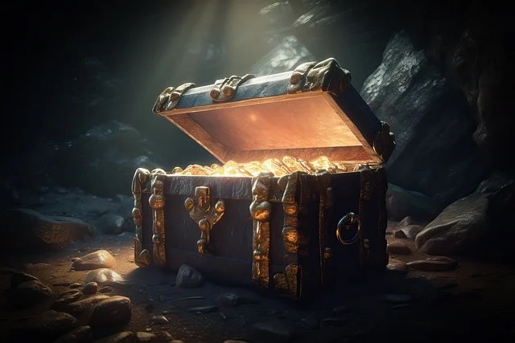
Treasure Hunt Game
Using Path Finding Algorithms

Slide 2
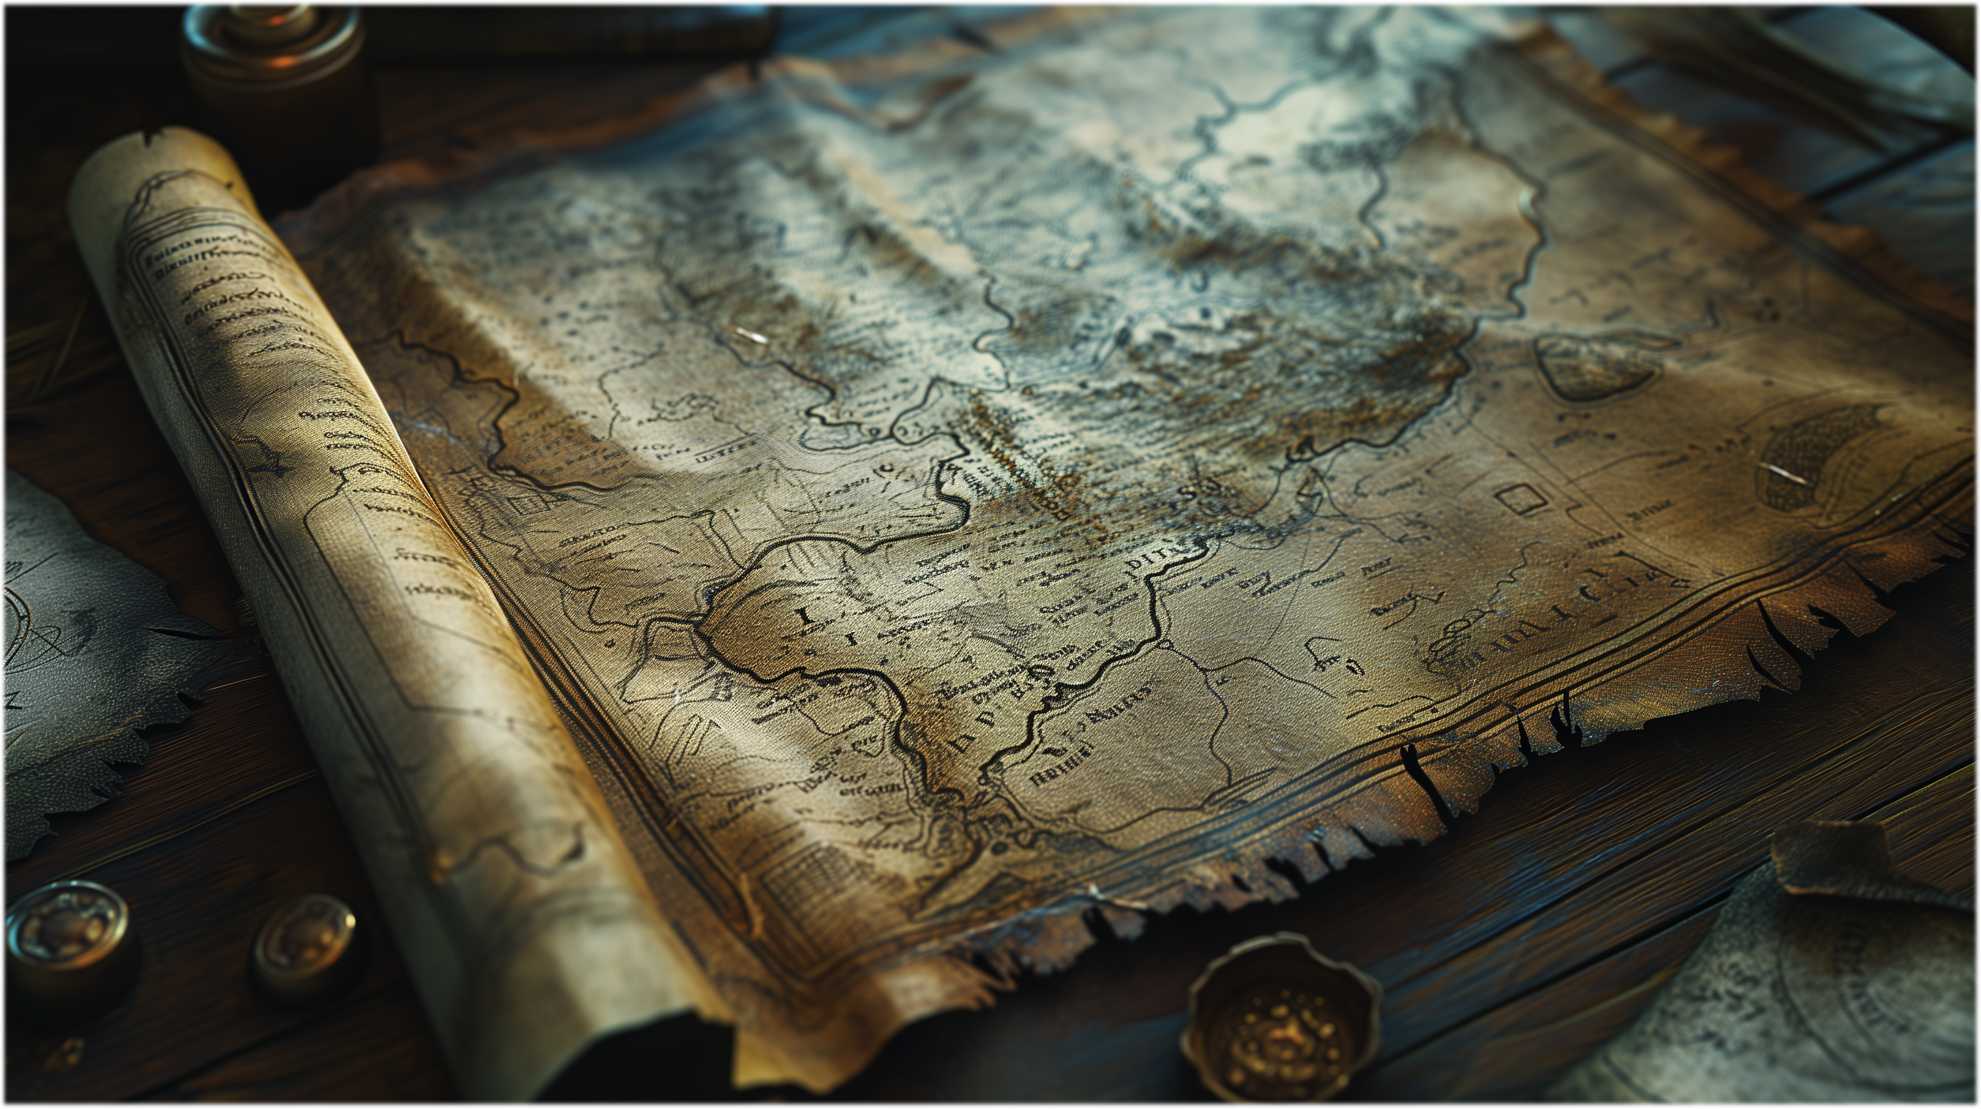
Abstract
This project implements an interactive Treasure Hunt Game that challenges player.
it which we use the basic algorithm and implement the code.
Implements BFS algorithm for pathfinding algorithm.
Player input is taken for directional moves (W, A, S, D).

Slide 3
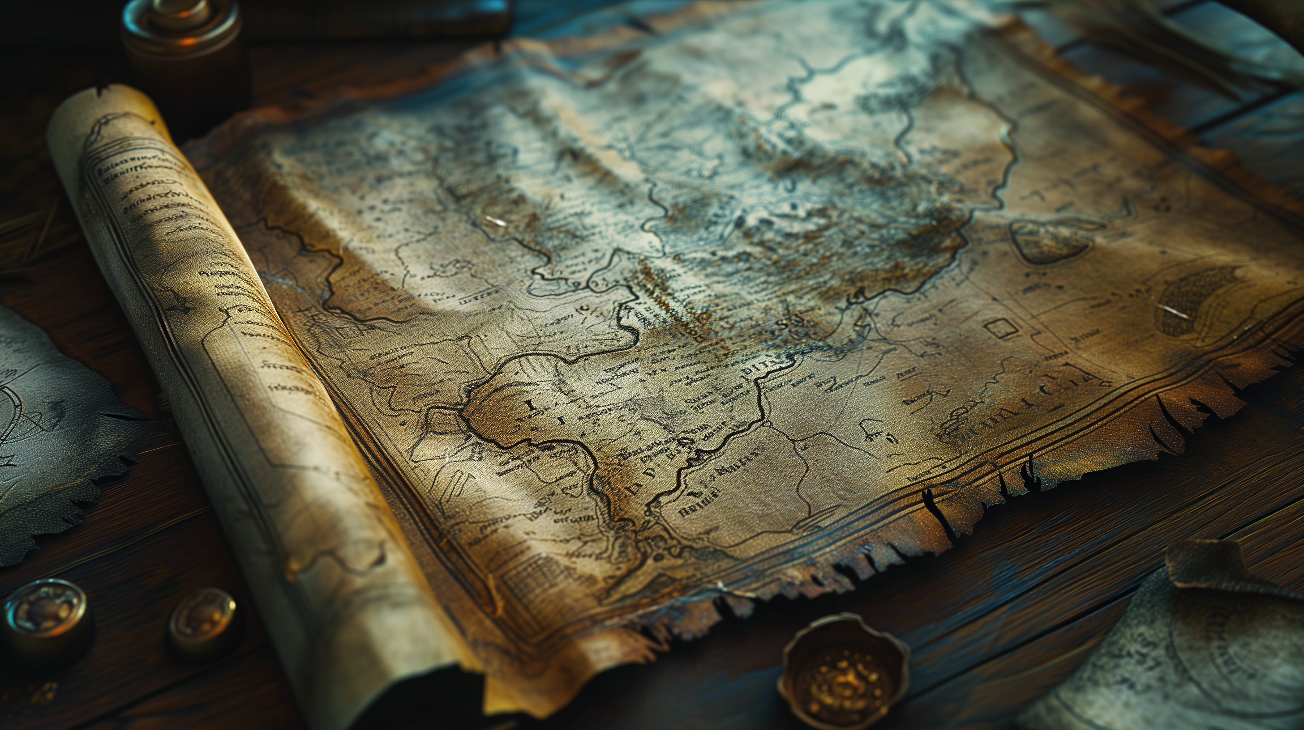
METHODS
1.void initialize_game()
Purpose: Sets up the game board, places a treasure at a random location, initializes the player position, and sets the score to zero.
2.void render_board(char grid[GRID_SIZE][GRID_SIZE], Player player)
Purpose: Displays the current state of the game board, showing the player’s position, empty spaces, obstacles, and the treasure.
3.void move (Player& player, char grid[GRID_SIZE][GRID_SIZE], char direction)
Purpose: Accepts a direction (up, down, left, right) and moves the player accordingly if the move is valid.
4.void add_new_obstacle (char grid [GRID_SIZE][GRID_SIZE], int numObstacles)
Purpose: Randomly places a specified number of obstacles on the grid in empty spaces.

Slide 4

Basic Introduction of Game
The game involves a random grid where a player must find hidden treasure within a limited number of moves.avoiding obstacles scattered randomly on the grid.
The player starts in the top-left corner and can move up, down, left, or right.
If they get close to the treasure, a hint is provided.
The game ends if the player finds the treasure or exhausts all available moves.

Slide 5
Key Features of the Treasure Hunt Game
Grid Setup: Initialises a grid map with a treasure and random obstacles.
Player Start Position: The player starts in the top-left corner and navigates using directional inputs.
Movement and Boundaries: Each move checks for grid boundaries and obstacles to ensure valid player movement.
Game End Conditions: The game ends when the player finds the treasure or uses all available moves.

Slide 6

Algorithm used
1. Breadth-First Search (BFS):
• Purpose: Finds the shortest path to the treasure.
• Mechanism: Explores all neighboring cells level by level using a queue.
• Advantages:
• Guarantees the shortest path in an unweighted grid.
• Provides distance hints to the player after each move.
Implementation:
• Starts from the player’s position, marking visited cells.
• Returns the distance once the treasure is reached.

Slide 7
Overall Time Complexity
Since displayGrid and bfs are called in every loop iteration, the combined complexity for each move is
O(GRID_SIZE²+GRID_SIZE²) = O(GRID_SIZE²)
The loop can run up to MAX_MOVES times, the overall time complexity is:
O(MAX_MOVES×GRID_SIZE²)
If MAX_MOVES is proportional to GRID_SIZE² (e.g., allowing for moves across the entire grid), then the complexity simplifies to:
O(GRID_SIZE⁴)
Overall Space Complexity
Grid Storage: O(GRID_SIZE²), for storing the grid itself.
BFS Queue and Visited Array: O(GRID_SIZE²), for marking visited cells and storing
positions in the queue.
Thus, the space complexity is:
O(GRID_SIZE²)
Overview of time analysis:
Overall Time Complexity: O(GRID_SIZE⁴) (assuming MAX_MOVES is proportional to GRID_SIZE² ).
Overall Space Complexity: O(GRID_SIZE²).

Slide 8

Modules
Grid Initialization and Management Module:
To create and manage the game grid, ensuring it starts in a clean state and includes essential elements
Randomized Treasure and Obstacle Placement Module:
To ensure that the game has varying challenges by randomly placing the treasure and obstacles each time
Map Module:
• The displayGrid() function visualizes the player’s position, obstacles, and the treasure.
• The placeObstacles() function manages obstacles on the grid, setting the stage for player navigation.

Slide 9
Player Movement and Interaction Module:
To facilitate player movement across the grid and provide feedback based on interactions with the game
Pathfinding Algorithms Module:
To implement algorithms that help find the shortest path to the treasure, guiding the player through the grid
Game State Evaluation Module:
To assess the current status of the game, including win conditions and available
Input Handling Module:
To manage user inputs for controlling the player’s movements and making game choices.

Slide 10

Result
The game randomly places a treasure and obstacles based on a grid.
The player has random moves to find the treasure, guided by BFS hints showing the shortest path.
Upon finding the treasure, the game congratulates the player with the move count.

Slide 11

Conclusion
The main function implements a text-based treasure hunt game, where a player navigates through a grid to find a hidden treasure while avoiding obstacles. The game board is represented as a grid of size GRID_SIZE, where the player’s position, obstacles, and the treasure are placed. The game starts by randomly generating the position of the treasure and placing a few obstacles on the grid. The player begins at the top-left corner of the grid (position (0, 0)).
The player can move in four directions: up (W), down (S), left (A), and right (D). After each move, the program checks if the player has reached the treasure. If the player lands on the treasure’s position, the game congratulates them and ends, displaying the number of moves it took to find the treasure.
Additionally, the program informs the player if they are near the treasure (i.e., if they are one move away). The game uses the Breadth-First Search (BFS) algorithm to calculate the shortest number of moves to reach the treasure from the player’s current position. After every move, the program runs the BFS to determine and display the shortest path to the treasure.

Slide 12

Thank You
AP23110010977 - T. Satya Vardhan
Any
Questions???

